Slide 1
FIRST WORKSHOP OF
TEMPUS MASTER
DEGREE PROGRAM

Slide 2
Project title:
establish a new master
Degree in biotechnology
applied
To AGRi-science,
environment
And pharmacology

Slide 3
The shared Universities:
Egyptian Universities | European union Universities
1- Fayoum University | 8-Consiglio Nazionale Delle Ricerche, IPP UOS BARI( ITALY)
2- Aswan University | 9-Institute of Biodiversity and Ecosystem Research-BAS, Sofia(Bulgaria)
3- Minia University | 10-Medical University of Vienna (Austria)
4- Zagazag University | 11-Universitat de Barcelona (Spain)
5-Sinai University | 12-Oldenburg University (Germany)
6- MUST University | 13-University of natural resources & life science, Vienna (Austria)
7-Benha University

Slide 5
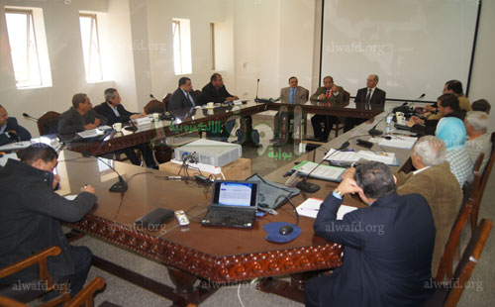

Slide 10
THANK YOU

